Slide 1
Research Agent
CAPSTONE PROJECT
Presented By: Manish Shukla
Student name : Manish Shukla
College Name & Department : Graphic Era Hill University, SOC Department

Slide 2
OUTLINE
Problem Statement
Technology used
Wow factor
End users
Result
Conclusion
Git-hub Link
Future scope
IBM Certifications

Slide 3
Problem Statement
A Research Agent is an AI system designed to assist with academic and scientific research tasks. It can autonomously search for literature, summarize papers, and organize references. Using natural language processing, it understands research questions and retrieves relevant information. The agent can generate reports, suggest hypotheses, and even draft sections of research papers. It saves time by automating repetitive tasks like citation management and data extraction. Research Agents enhance efficiency, accuracy, and innovation in both academic and industrial R&D.

Slide 4
Technology used
IBM cloud lite services
IBM Granite model

Slide 5
IBM cloud services used
IBM Cloud Watsonx AI Studio
IBM Cloud Watsonx AI runtime
IBM Cloud Agent Lab
IBM Granite foundation model

Slide 6
Wow factors
The Research Agent impresses with its AI-powered ability to search, summarize, and organize academic content. It uses IBM Granite models for intelligent text generation and automation. This tool boosts research productivity by handling complex tasks like hypothesis generation, citation management, and report drafting—all within IBM Cloud Lite’s free, scalable environment.
Key Highlights Factors Are:
Smart, autonomous research powered by IBM Granite AI.
Instant paper summarization and auto-generated citations.
Fully deployable on IBM Cloud Lite.

Slide 7
End users
Academic Researchers
Students
Data Scientists & AI Engineers
Research Institutions and Universities
Industry R&D Teams
Educators

Slide 8
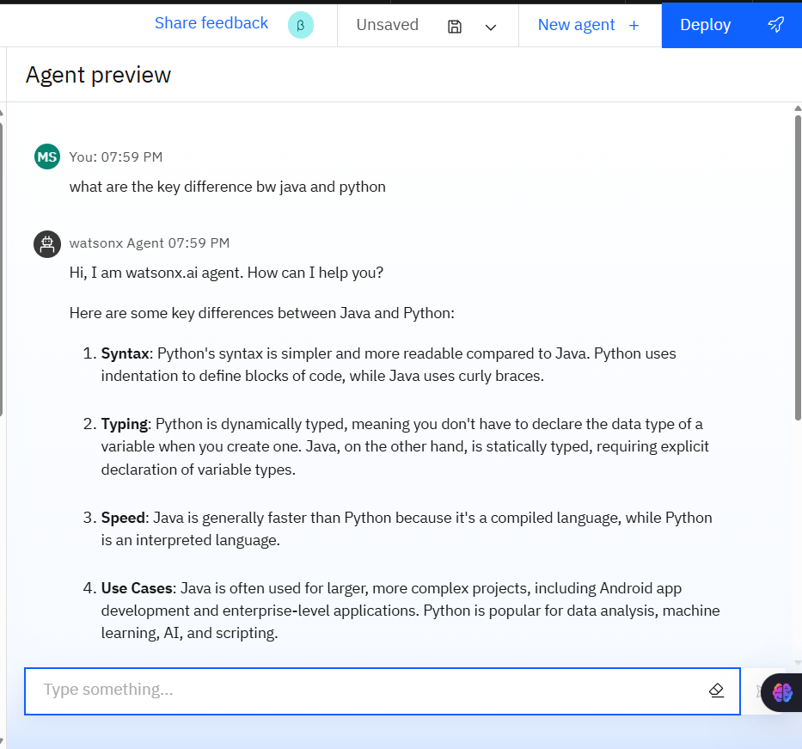
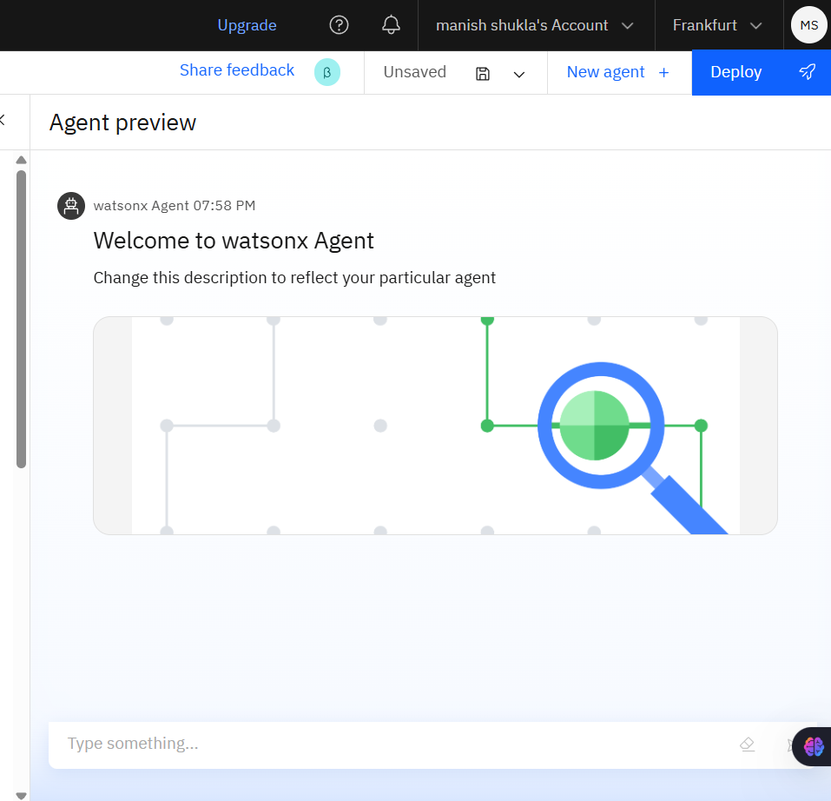
Results

Slide 9
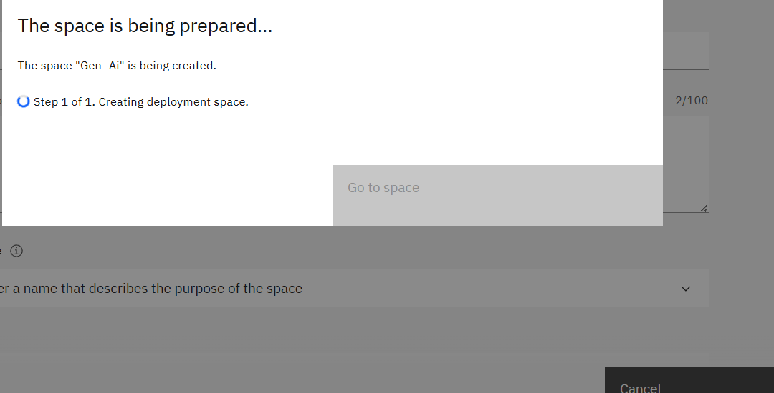
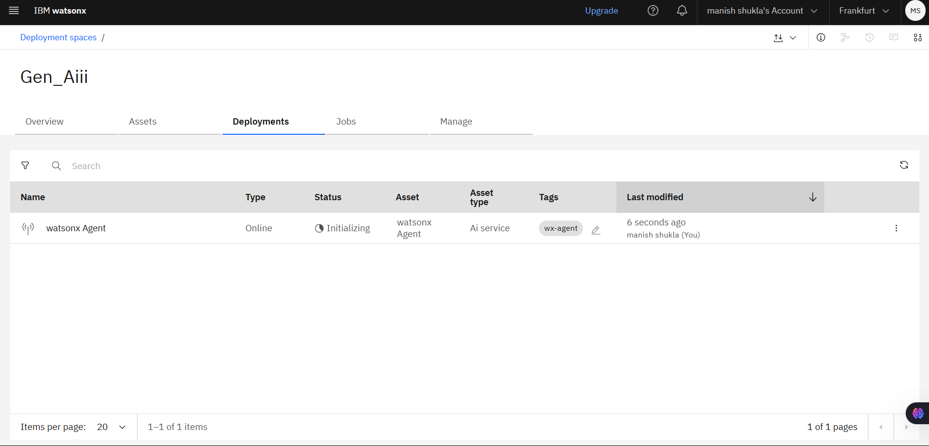
Results

Slide 10
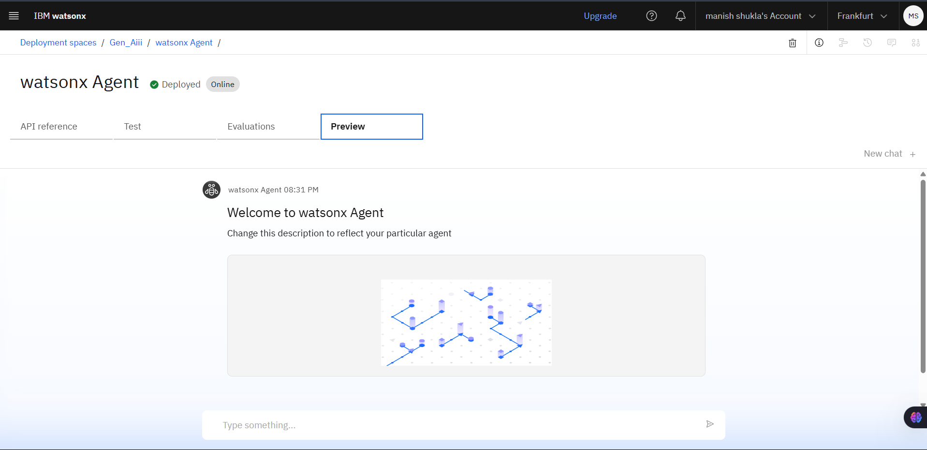
Results

Slide 11
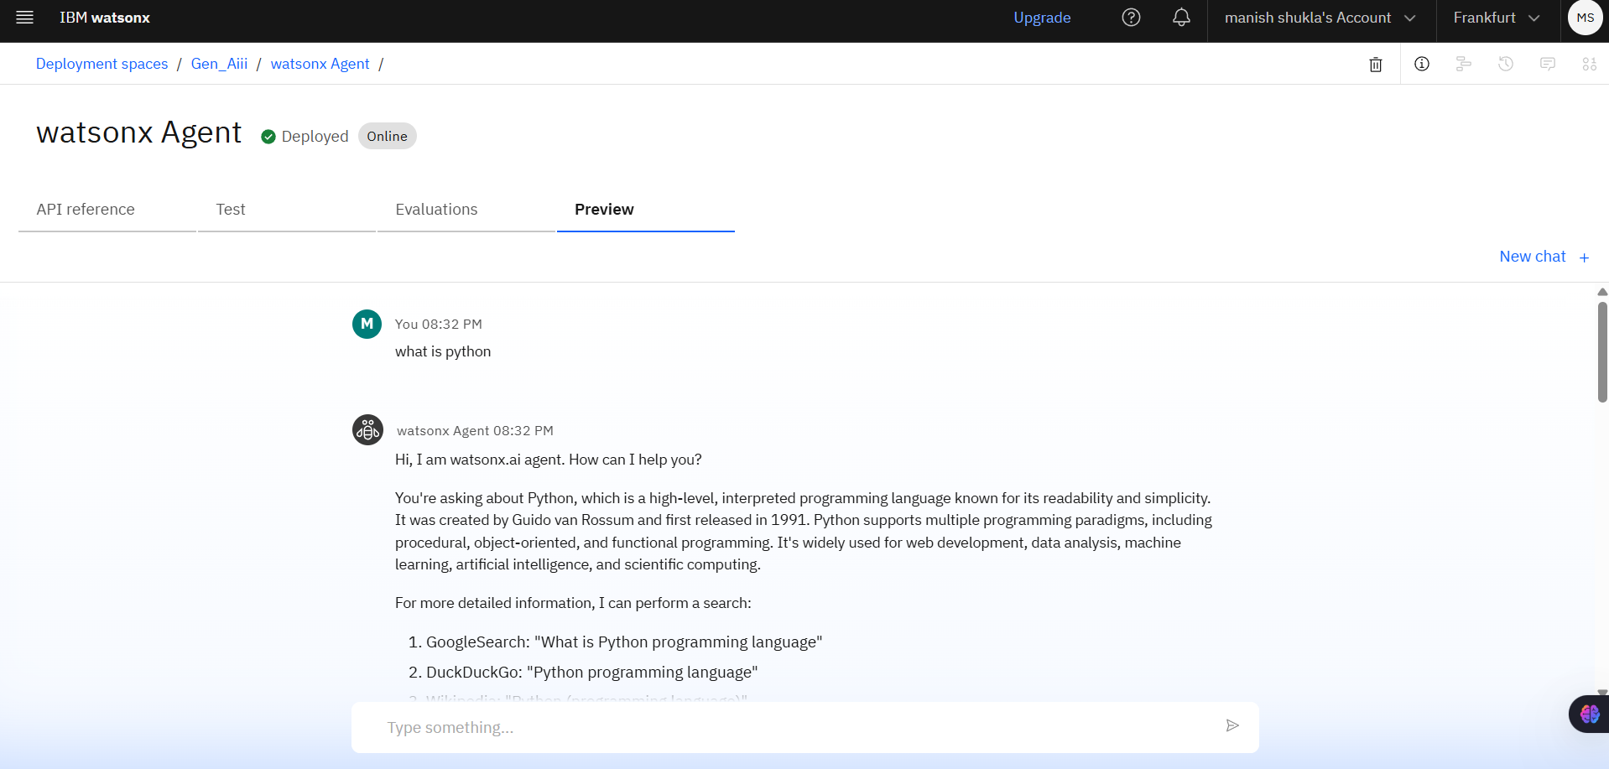
Results
Deployed AI Agent

Slide 12
Conclusion
Automates key research tasks like literature search, summarization, and citation management..
Leverages IBM Granite AI for intelligent content generation and hypothesis creation..
Cost-effective and scalable using IBM Cloud Lite’s free-tier infrastructure.
Empowers students, researchers, and professionals to work faster, smarter, and more efficiently

Slide 13
Future scope
Multilingual Research Support
Voice-Activated Research Assistant
Real-Time Collaboration Features
Research Gap and Novel Topic Identification
Integration with Publishing Platforms
AI-Assisted Paper Drafting

Slide 14
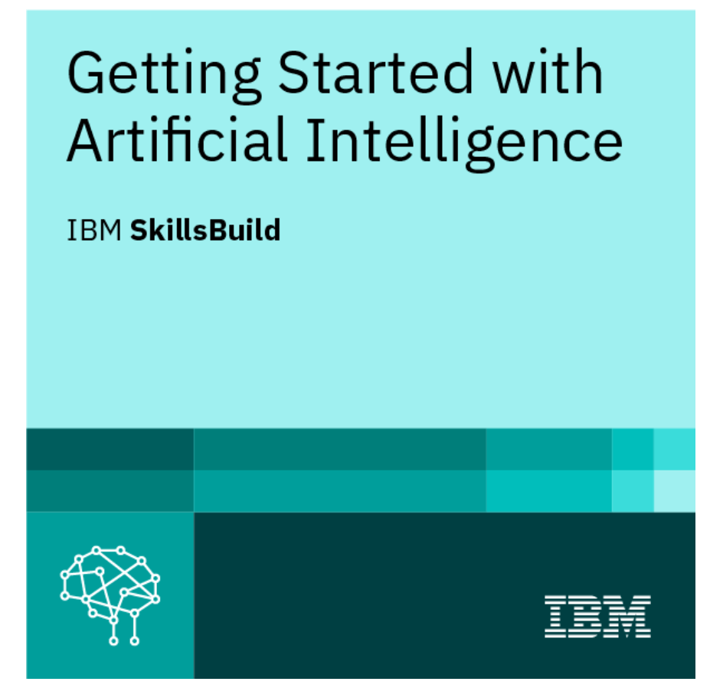
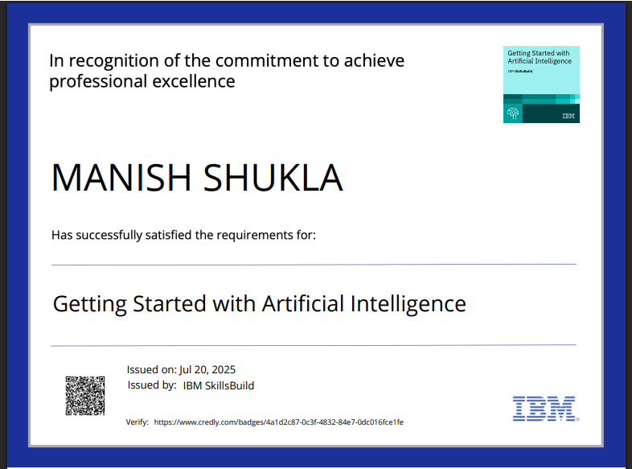
IBM Certifications

Slide 15
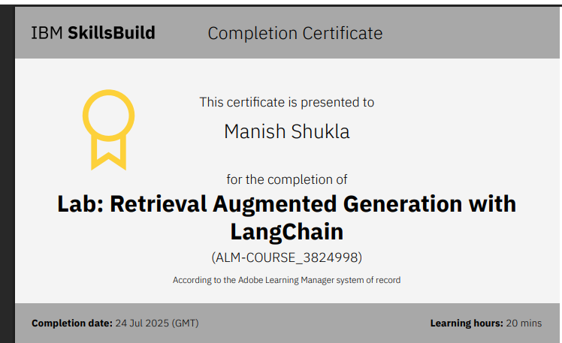
RAG CERTIFICATIONS

Slide 16
Github Link: https://github.com/Manish3Shukla/project_ai

Slide 17
GitHub Link
Make sure that there should be readme file
Link: https://github.com/Manish3Shukla/project_ai/blob/main/README.md

Slide 18
THANK YOU

